Slide 1
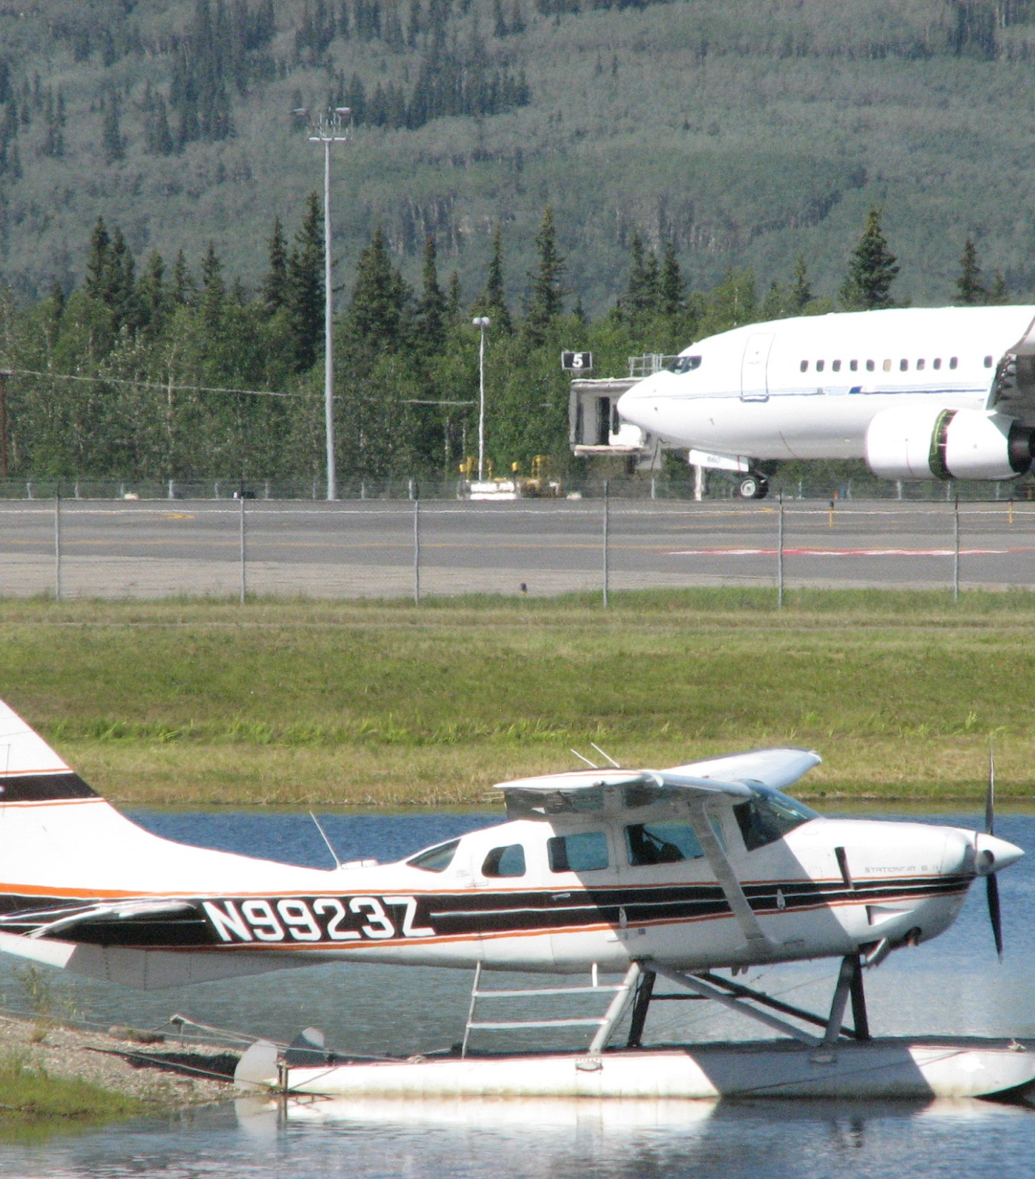
Building Alaska’s Rural Airports
Design and Construction Considerations
Lessons Learned

Slide 2
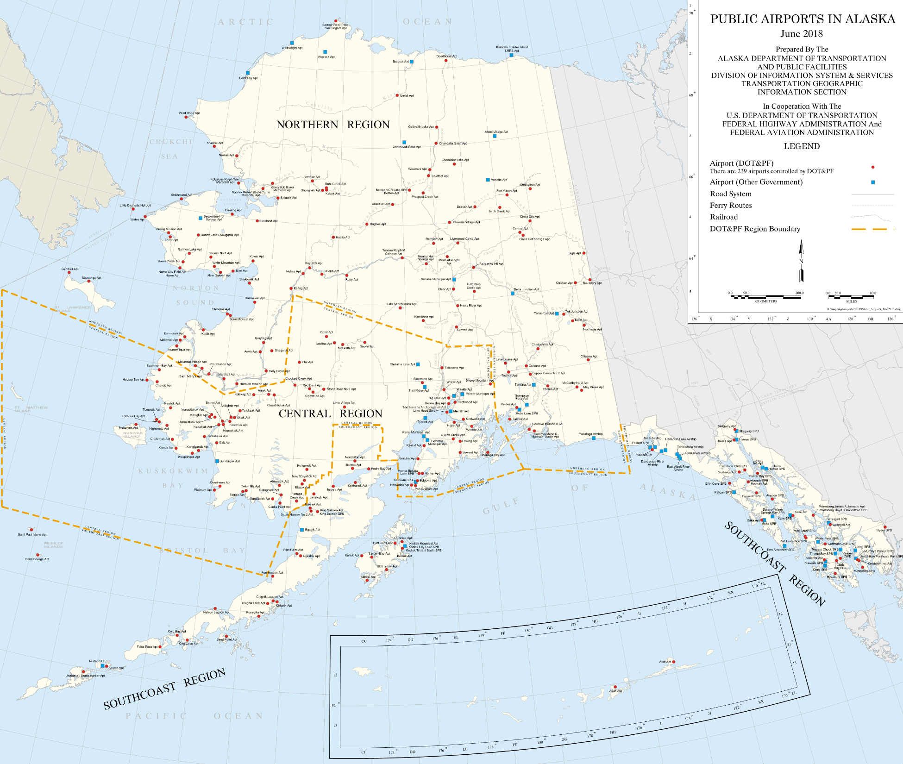
ALASKA AVIATION
700+ landing strips
DOT&PF owns and operates 239 airports
3 international airports
ANC is the 5th busiest cargo hub in the world
Notes:
Air transportation is the lifeline that allows Alaskans in the far north to connect with the world yet live in the area to preserve their heritage.
Aviation is a vital component of Alaska's transportation system. Whether living in Anchorage or a small community in the Aleutians, air service is the lifeline that connects all Alaskans to other communities in the state, the Lower 48, and the world. Alaska's airports serve the transportation needs of state residents, support the movement of materials and goods, contribute substantially to the economy, and enable delivery of critical medical services. Over 700 facilities are registered in the State of Alaska, with the State of Alaska Department of Transportation & Public Facilities (DOT&PF) owning and operating 239 facilities statewide. Nearly 82% of Alaska communities are inaccessible by road, making aviation more than a convenience or a luxury - aviation is essential in the Alaskan way of life.
ANC has molded itself into a critical refueling stop for cargo carriers flying the skies between Asia and North America.
Located within a 91/2-hour flight from 90% of the industrialized world

Slide 3
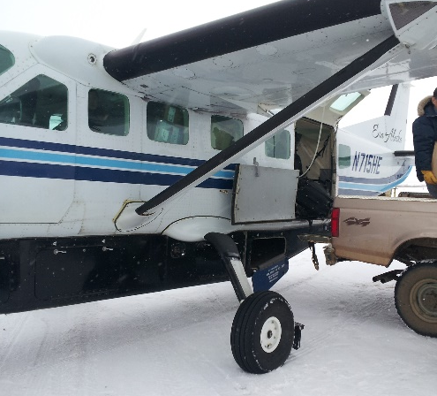
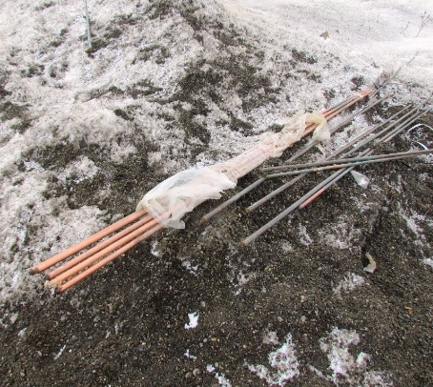
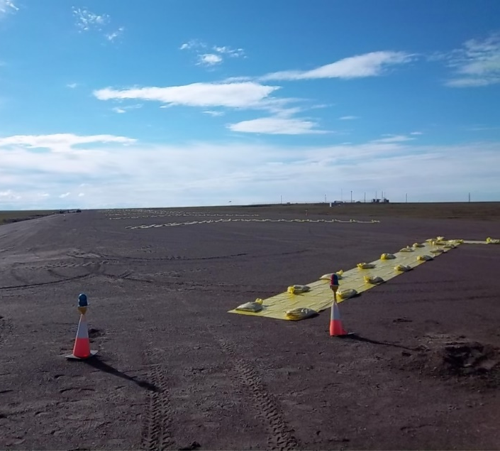
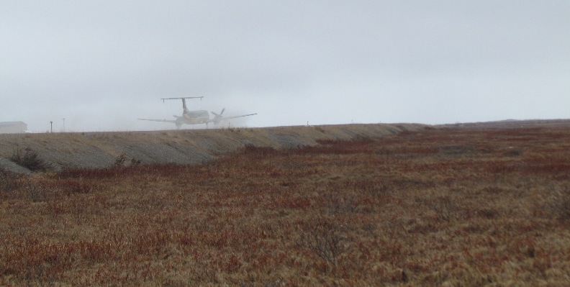
LESSONS LEARNED
Schedules
Logistics
Gravel
M&O
Permitting
Innovation
… staying humble

Slide 4
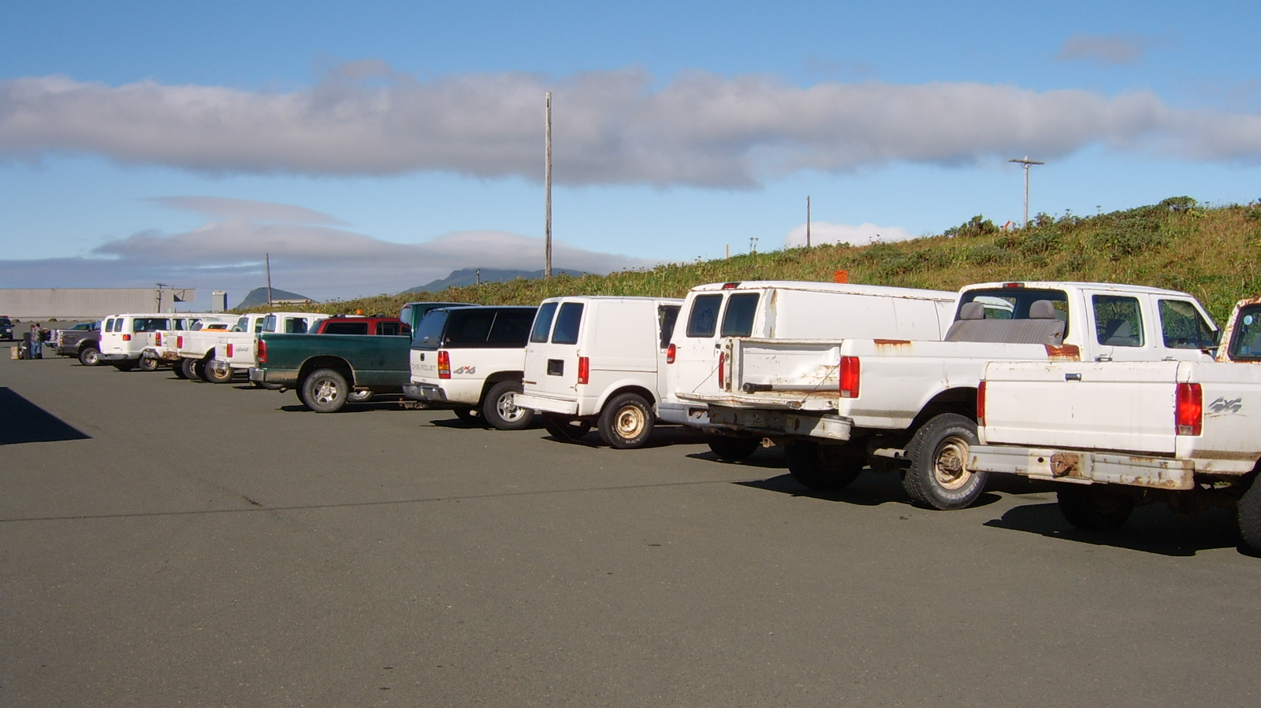

Slide 5

early procurement packages
allow for winter construction… caution!
fast track design and/or phased construction
SCHEDULES
SCHEDULES
short construction season
Notes:
The Arctic climate provides a short construction window of approximately 100 days of thawed conditions. That window is further compressed by the rainy season that tends to start in late-July continuing through freeze up in mid-September.
Prioritize engineering tasks and phase construction to optimize the construction schedule. It is critical for contractors to begin work as soon as they are able.
Specify owner-furnished material delivered to the site under a separate procurement. This allows the contractor to begin work immediately at break-up.

Slide 6
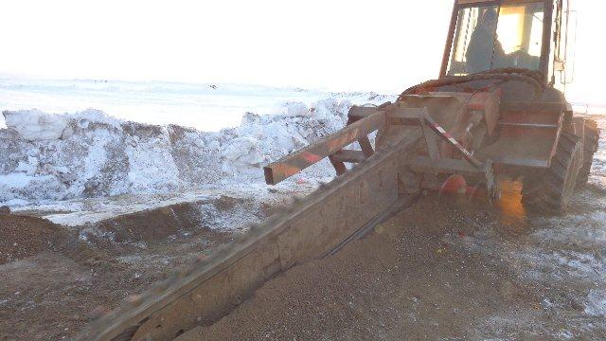
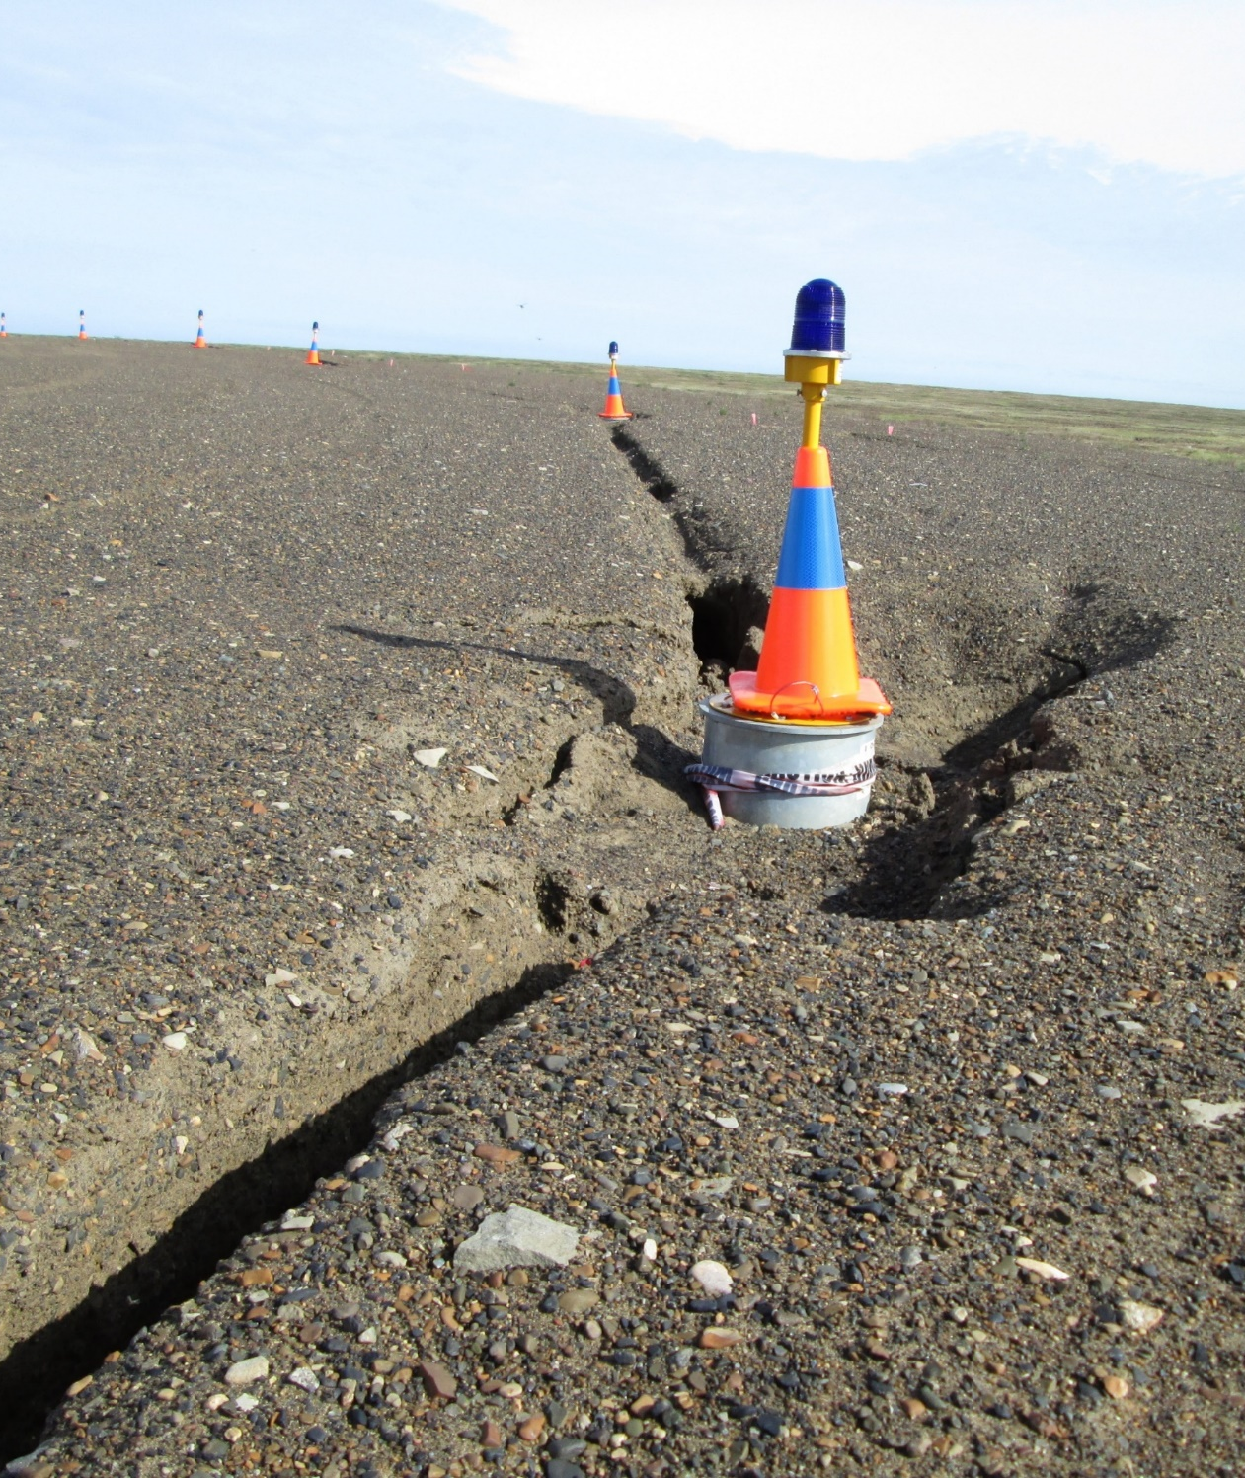
Working with frozen borrow material
Notes:
Working with frozen borrow material
Frozen borrow materials are expected to have soil moisture contents above thawed state saturation levels. Frozen borrow processed and placed directly from in-place sources will require drainage during and after initial thaw. During this period, significant soil strength loss should be anticipated.
Only a couple of months are available for the thawing, drying, and placing material. If the material requires processing, work times become more condensed.
While it is the contractor’s responsibility to develop means and methods (including dewatering and soil moisture conditioning) that will achieve the specified compaction requirements, the design must allow for additional material processing time in the construction phasing schedule.

Slide 7
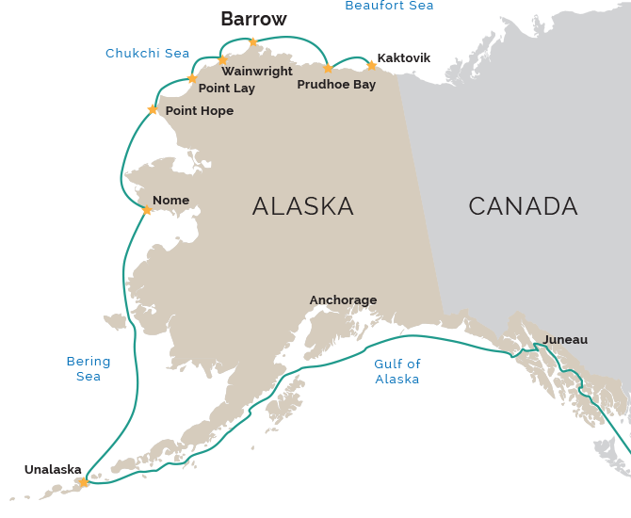
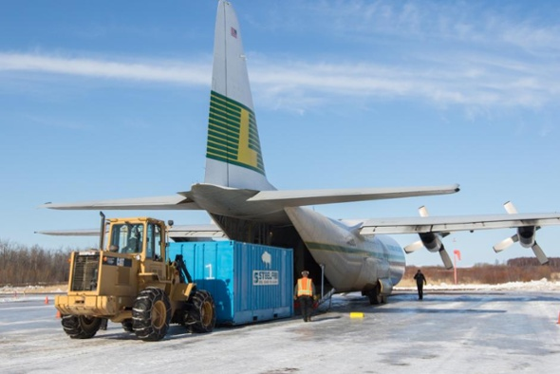
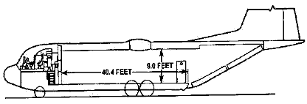
LOGISTICS
Mobilization and delivery of large materials
Notes:
Access to each village is unique with respect to logistics, timing, and cost.
Schedule engineering activities and phase construction to fit the optimum window for contractor
access.
Have used separate bid packages to phase the work in order to hit barging and ice road windows.
Marine Transportation:
Receiving dates for Prudhoe Bay Service: July 25th through August 15th
The overall construction schedule will be driven by weather, the barging window, and barge availability and capacities. The typical barging window for the Chukchi Sea is a 50-day period from about July 20th to about September 10th.
Surface Transportation
C-130/L-382 Hercules Aircraft Capabilities
The L-382 Hercules is the most reliable, versatile and powerful aircraft available for hauling oversized loads to and from remote areas. Lynden Air Cargo pilots can deliver your supplies into the most isolated Bush locations without road access or runways carrying a payload of up to 48,000 pounds. The Hercs can handle a full-load or less-than-charter-sized load - whatever your unique project needs might be. Straight-in loading capabilities, an adjustable rear cargo ramp and a floor height at truck-bed level allows us to carry a variety of shapes and sizes.
Our Hercs have been used to move materials and supplies for some of the biggest construction, oil and mining projects in Alaska. We've got the process down. We provide simplified loading operations for quick turnarounds, direct loading from ground or truck, drive-on/drive-off vehicle loading, and we make the most of your cargo space by stacking full-height rectangular shaped loads. We have years of experience moving heavy machinery, vehicles, cranes, building materials and a whole lot more. Leave it to us. We'll get it there. Wherever there is.
****Alaska map = Bowhead transport

Slide 8
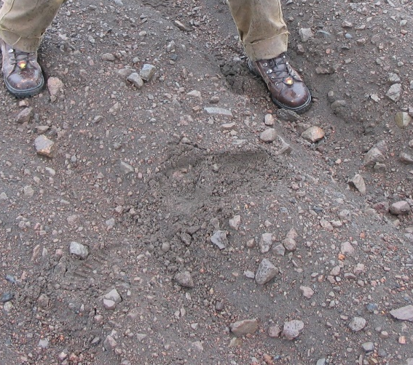
GRAVEL
Availability
Quality
Quantity
Processing requirements
The cost and availability of gravel is unique for every project. Case-by-case creative solutions are needed to deliver material at the lowest possible cost.
Notes:
Estimating quantity of materials needed for the project will be extremely important due to timing and logistical challenges from procurement, source development, and extraction techniques, to delivering, processing, thermal-conditioning, and moisture-conditioning needed.
Underestimating material quantities could detrimentally delay the project schedule. Significant contributors which could all lead to underestimating materials include: mining techniques and timing; excess ice or moisture in mineral soils; hauling/bulk tonnage versus in-place tonnage; processed desirable versus reject material ratios; and construction means and methods.
Typical gravel extraction techniques in the Arctic involve mining during the winter season when the active layer is frozen down to the top of permafrost. Large rippers or drilling and blasting techniques are often used to process materials into manageable frozen chunks ranging from a few inches to over a foot; the frozen chunks are comprised of a conglomeration of bonded soils in their frozen matrix including gravels, sands, and variable amounts of ice and silt. Mining outwash and alluvial materials within thawed taliks commonly encountered beneath larger rivers such as the Sag, Put, Kuparuk, and Colville is also a relatively common technique.

Slide 9
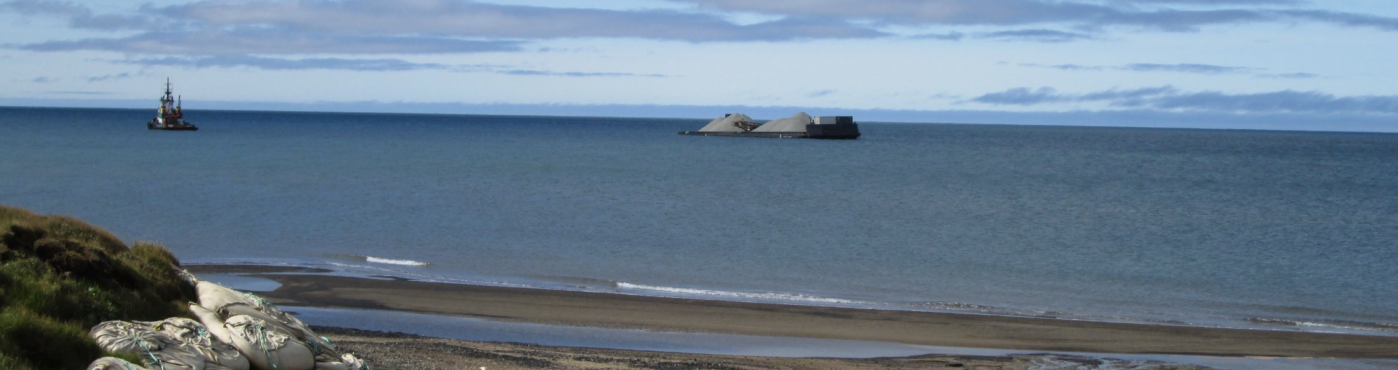
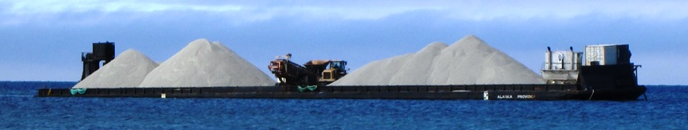


Slide 10
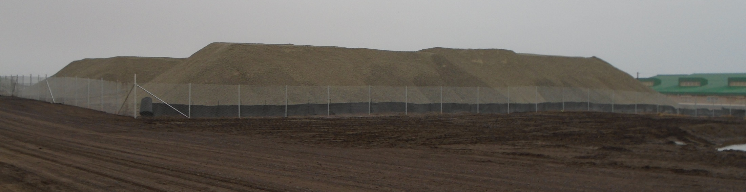
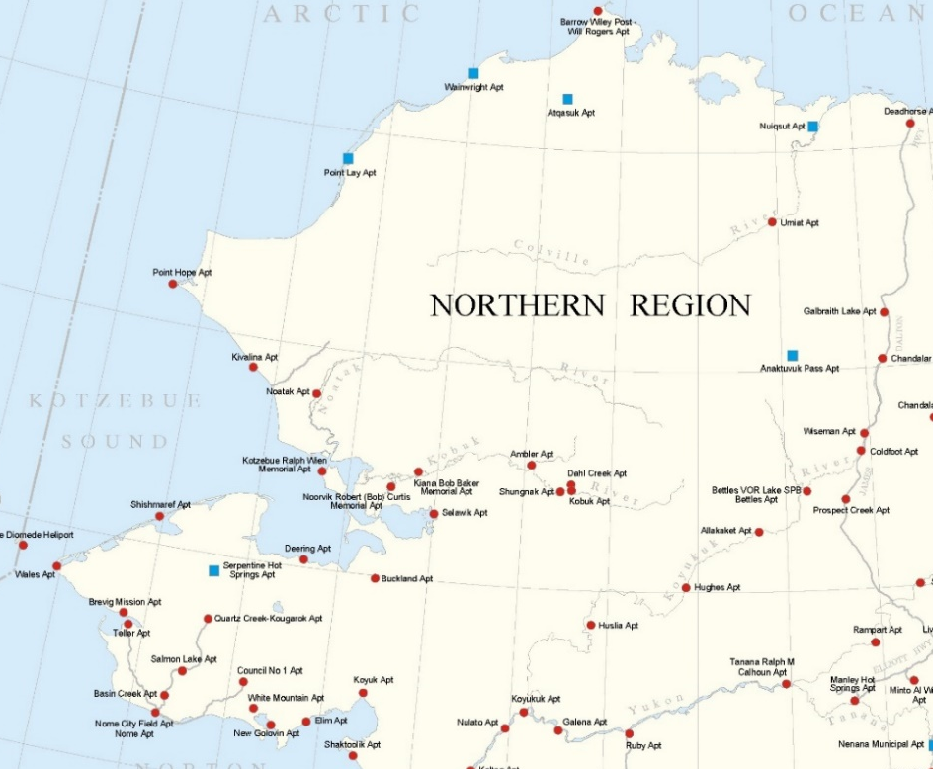
Location | Unit price
Wainwright | $435.00 / CY
Atqasuk | $520.00 / CY
Nuiqsut | $233.00 / CY
Nome | $96.00 / CY
Cold Foot | $20.00 / CY

Slide 11
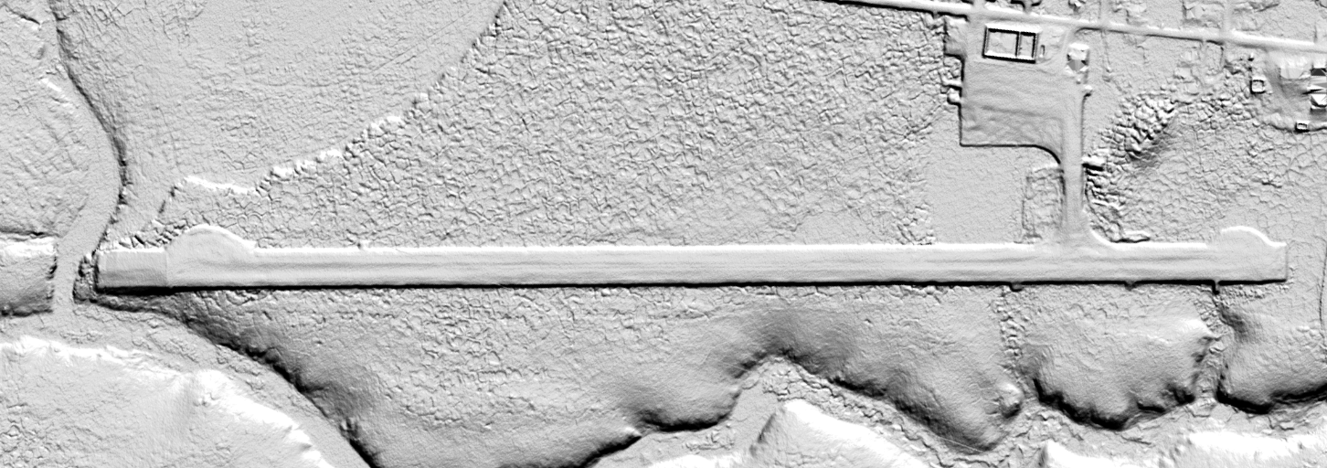
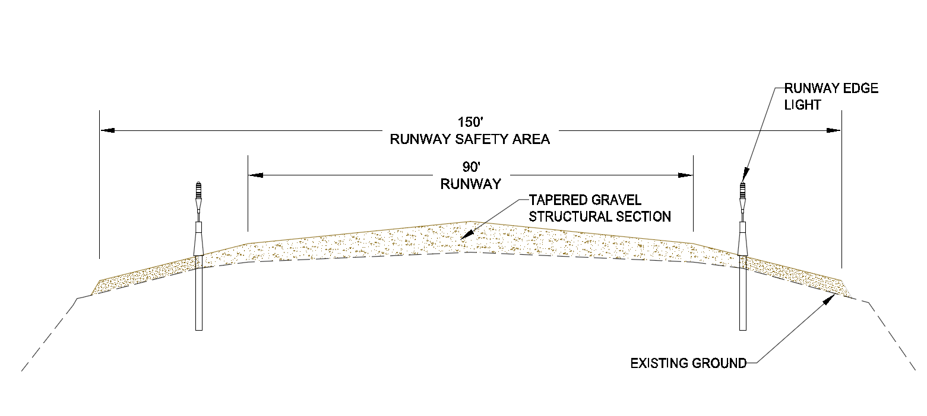
MAINTENANCE & OPERATIONS
Contract labor
Keep it simple

Slide 12
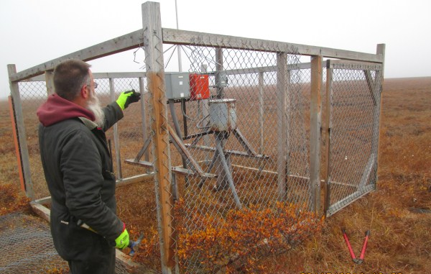
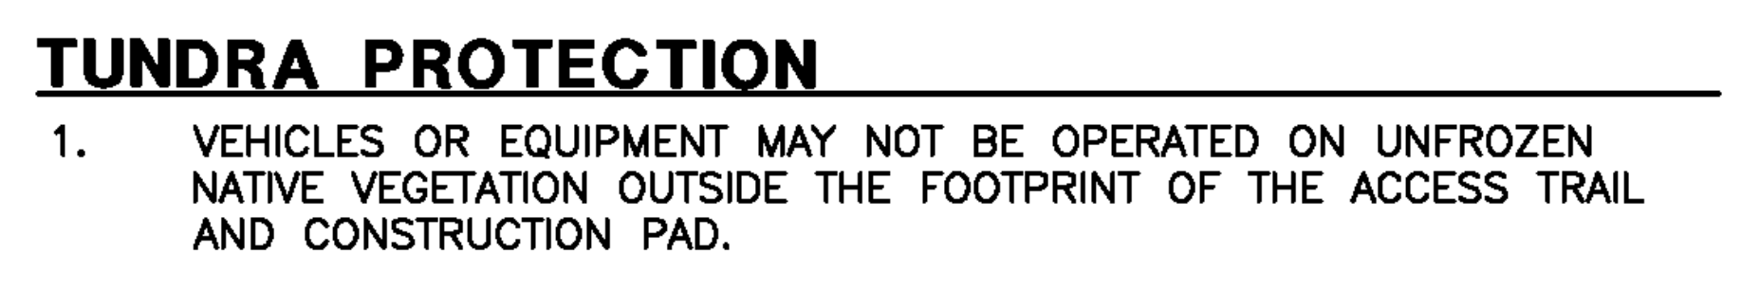
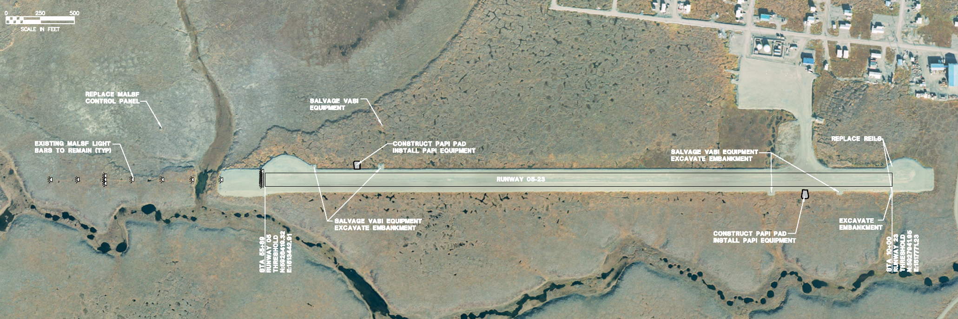
PERMITTING

Slide 13
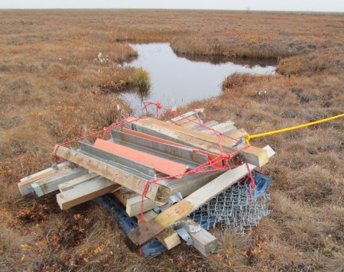
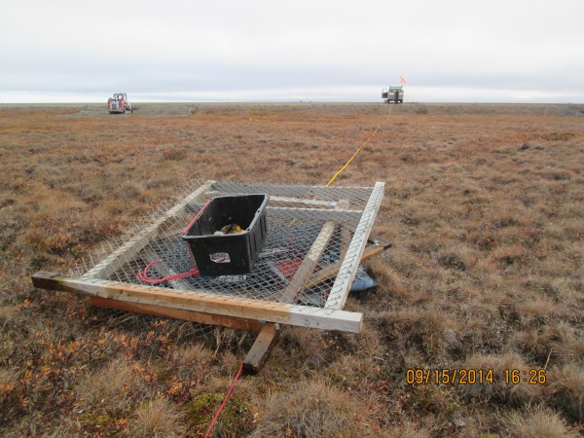
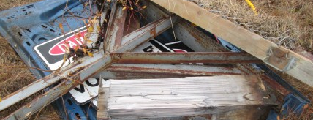

Slide 14
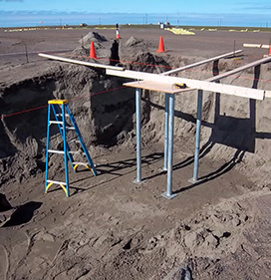
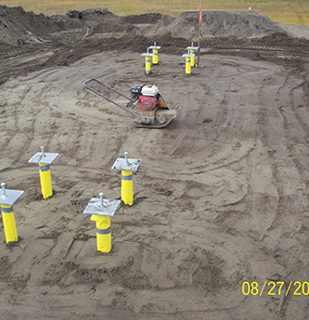
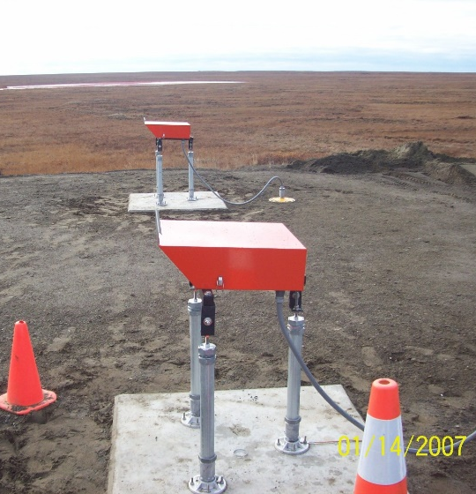
INNOVATION

Slide 15
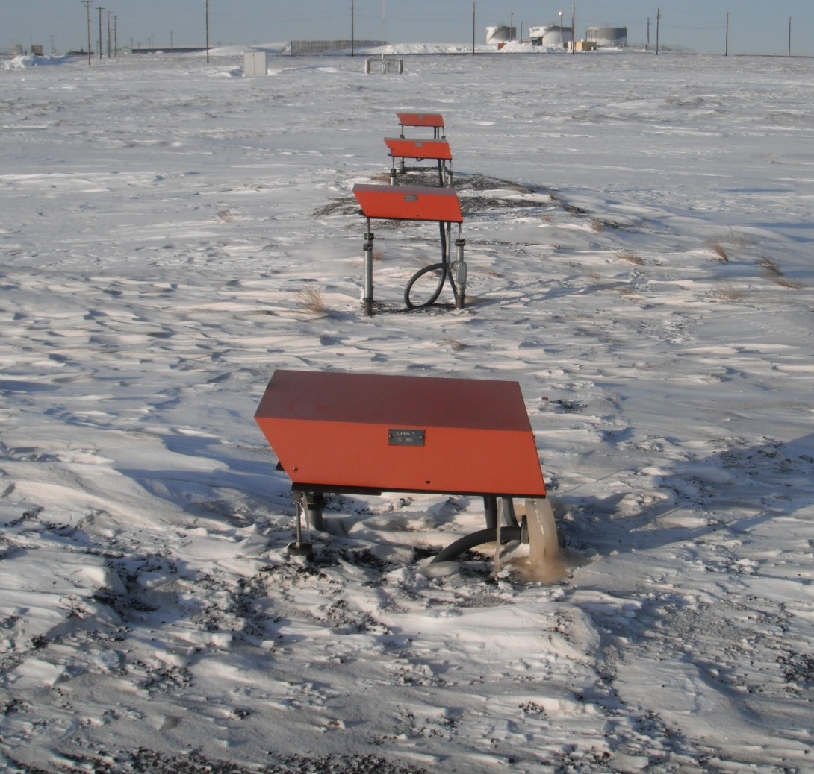
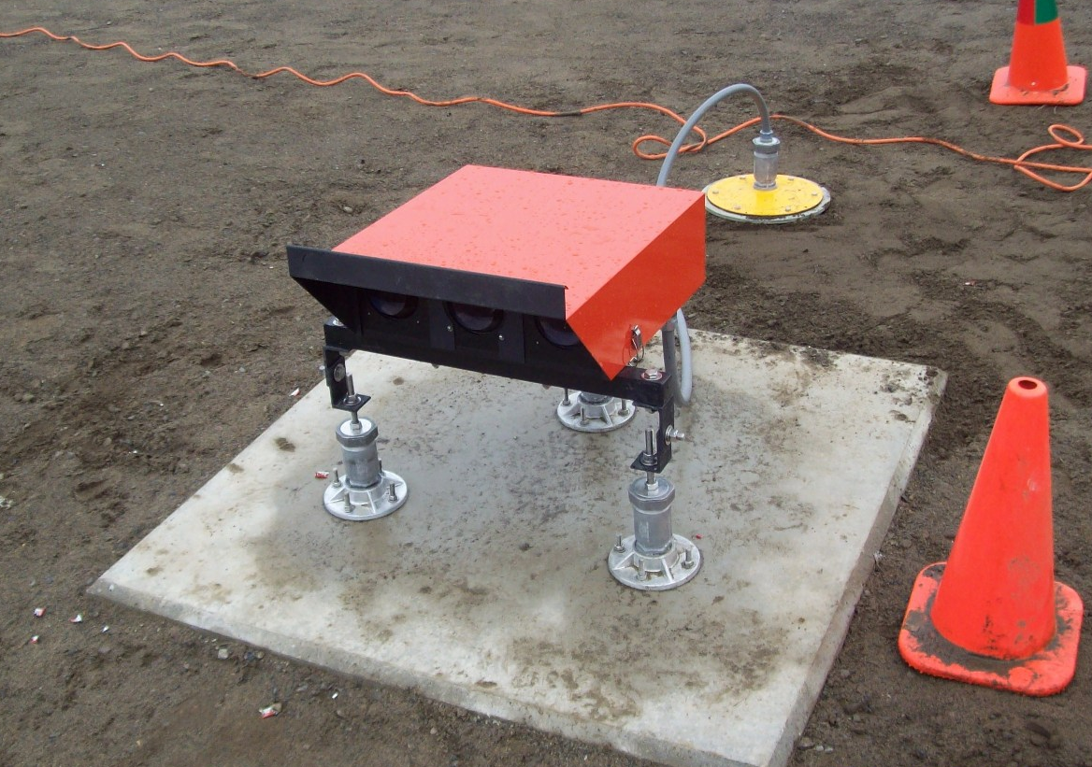
STAY HUMBLE
it is the only way to keep growing

Slide 16
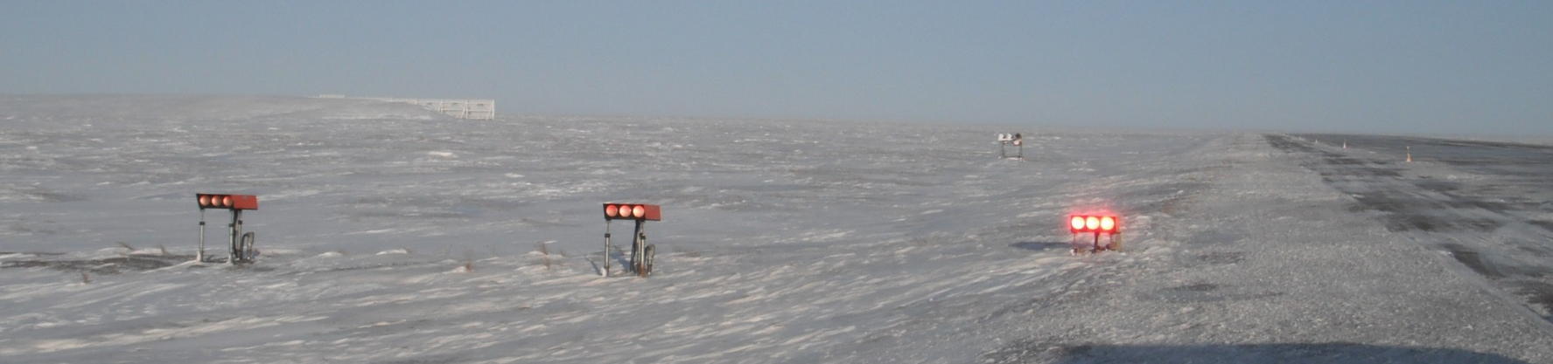
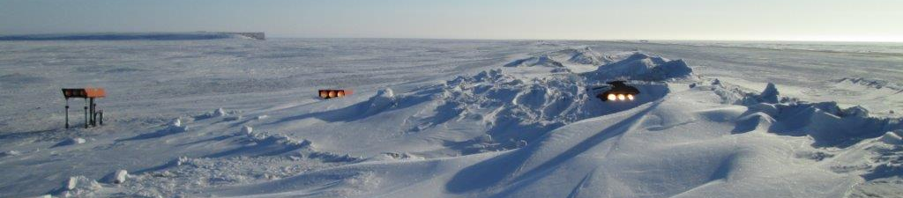

Slide 17
Thank you!
Questions?
Angela M. Smith, PE
Associate | Aviation Group Manager

